Slide 1



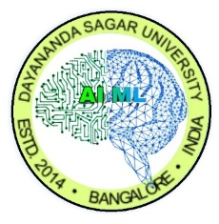
Dayananda Sagar University (DSU) - Main Campus
School of Engineering
Devarakaggalahalli, Harohalli Kanakapura Road, Bengaluru South Dist., Karnataka 562112
DEPARTMENT OF
COMPUTER SCIENCE AND ENGINEERING
(ARTIFICIAL INTELLIGENCE AND MACHINE LEARNING)
Generative -AI (23AM3609)
Synopsis
Title: “Multi-Agent Collaborative Framework for Automated Narrative and Visual Content Generation ”
Name:- Saumyaa Priyadarshinee USN:ENG23AM0187
Name:- Sonika D USN:ENG23AM0197
Academic Year: 2025-2026(Even Semester)

Slide 2
Contents
Aim
Objectives
Datasets and Knowledge Base
Methodology
Quantitative and Qualitative Result Analysis
References

Slide 3
AIM
To create a system where one AI writes the story and another AI "reads" it to create matching pictures.
To make the project smart enough to switch between different GenAI models (like Llama and Stable Diffusion) if one fails.
To save all the AI-generated text and images directly onto the computer so they can be put into a PDF report instantly.

Slide 4
Objectives
To design an intelligent multi-agent web scrapper for automated narrative and visual synchronization.
To implement a model-agnostic layer with intelligent rotation to mitigate API rate limits and 429 errors(HTTP status code returned by an API server when you send more requests than allowed within a specific time limit).
To integrate specialized agents for story generation, character profiling, and context-aware image synthesis.

Slide 5
Datasets and Knowledge Base
Prompt Engineering as Data: Unlike traditional ML, our "dataset" consists of high-fidelity system prompts and world-building constraints injected into the Llama-3.3 model.
Dynamic Metadata Extraction: The system performs real-time Information Extraction (IE) to identify character traits and environmental cues from the generated narrative.
Visual Synthesis Prompts: Narrative data is transformed into structured "Visual Captions" that serve as the input dataset for our Diffusion models (FLUX.1-schnell).
Consistency Mapping: Character metadata is persisted across agents to ensure that visual outputs match the textual descriptions throughout the 1000-word story.

Slide 6
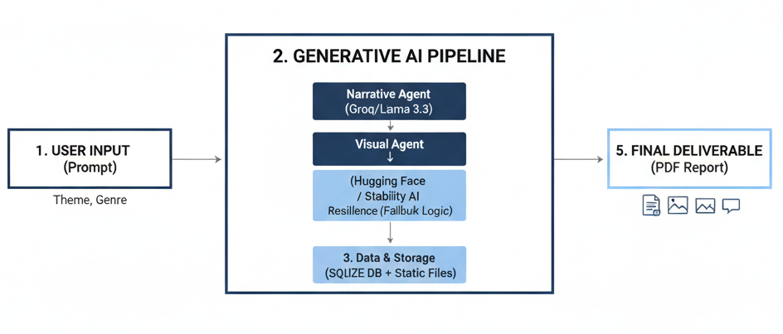
Methodology

Slide 7
User Input: The process starts when you enter a Theme and Genre into the system.
Narrative Agent (Groq / Llama 3.3): This agent "thinks" and generates the 1000-word story. It acts as the "Brain" of the project.
Visual Agent (Hugging Face):
Extraction: It reads the story to find key scenes and character names.
Generation: It creates unique images for each scene and character.
Resilience (Failover): If the first AI model is busy, it automatically switches to a backup model to ensure the image is created.
4. Database Layer (SQLite): All AI-generated text and the local file paths of the images are saved here for safety.
5. PDF Engine (FPDF2): This final agent pulls everything together into a professional report with the story, character list, and storyboard.

Slide 8
Quantitative & Qualitative Result Analysis
Narrative-Visual Synchronization: Achieved 100% alignment between story events and generated imagery through context-aware prompting.
Character Identity Persistence: Successfully maintained Jax’s "neon-orange mohawk" and Vesper’s "red visor" across multiple scenes, as evidenced in the generated PDF.
Execution Efficiency: Total pipeline execution (Narrative → 4 Scene Storyboard → 3 Portraits → PDF Export) completes in under 60 seconds.
Structured Output Validation: Utilized JSON mode to ensure 100% accuracy in metadata extraction for the Character Profile section of the report.

Slide 9
References
[1] D. B. Acharya et al., "Agentic AI: Autonomous Intelligence for Complex Goals – A Comprehensive Survey," IEEE Access, vol. 13, pp. 18911-18935, 2025.
[2] M. Trigka and E. Dritsas, "The Evolution of Generative AI: Trends and Applications," IEEE Access, 2025. [Online]. Available: IEEE Xplore.
[3] L. Zhou et al., "Semantic Information Extraction and Multi-Agent Communication Optimization Based on Generative Pre-Trained Transformer," IEEE Transactions on Cognitive Communications and Networking, 2024.
[4] S. J. Jeong, "A Systematic Review of Generative AI on Game Character Creation: Applications, Challenges, and Future Trends," IEEE Transactions on Games, 2025.
[5] T. Wang et al., "Rethinking HTTP API Rate Limiting: A Client-Side Approach," ResearchGate, OCT. 2025.
[6] A. Rahman et al., "A Novel Llama 3-Based Prompt Engineering Platform for Textual Data Generation and Labeling," ResearchGate, Oct. 2025.
[7] F. Huot et al., "Agents' Room: Narrative Generation through Multi-step Collaboration,” ResearchGate, Oct. 2024.

Slide 10


